Slide 1
PRESENTED BY PROJECT MANAGER :
DATE : 19/04 2025
BUSINESS CASE FOR PROJECT ARCO

Slide 2
PROJECT NAME: | PROJECT ARCO
PROJECT START DATE : | 22 OF APRIL 2025
PROJECT END DATE | 7TH OF JULY 2025
PROJECT SPONSOR | ARCO INSURANCE LIMITED
METHODOLOGY | PRINCE2 AND AGILE
BUDGET | 70,000 POUNDS
PROJECT LEAD | Mo Jones

Slide 3
TABLE OF CONTENT
Executive Project Summary
PROJECT INFORMATION
Table Of Content
Project Summary
Project Problem
Business Problem
Project Problem
Business Option
SWOT Analysis
Expected Benefits
ROADMAP Time Scales
INVESTMENT APPRAISAL
Risks, Issues, Assumptions And Dependencies
Project plans

Slide 4
PROJECT SUMMARY
This project aims to design, develop, and implement a new automated claims processing system for ARCO Insurance and Consulting Limited within an ambitious 8-week timeframe and a budget of £70,000. The primary goals are to significantly improve operational efficiency, reduce claims processing time, and enhance customer satisfaction. Leveraging the PRINCE 2 approach, this initiative places a strong emphasis on a robust Business Case to justify the investment, a clearly defined Organization structure outlining the roles of both ARCO consultants and insurance company staff and proactive Change Management to ensure a smooth transition to the new system.
The project will be executed in phases: Analysis, Design, Development, Testing, Training, and Deployment. Consultants will lead the technical aspects of analysis, design, development, and testing, while collaborating closely with allocated insurance company personnel who will contribute domain expertise, participate in user acceptance testing, and undergo comprehensive training.
Success will be measured by key performance indicators (KPIs) including a reduction in claims processing time, a decrease in error rates, a lower cost per claim and an improvement in customer satisfaction scores. Visualizations of these metrics before and after implementation will clearly demonstrate the project's impact. A critical aspect of this project involves effectively managing the interface between the consulting team and internal insurance stakeholders. Proactive strategies will be employed to address potential resistance to change and ensure a seamless migration of existing data to the new system. While the 12 -week timescale presents a significant challenge, a focused and well-managed approach, leveraging the expertise of both the consulting firm and the insurance company's staff, will be crucial to delivering a successful and impactful new claims processing system within the allocated budget. This project represents a strategic investment in modernizing ARCO's operations and enhancing its competitive edge.

Slide 5
Project Problem
This project faces challenges of major inefficiencies in ARCO Insurance and Consulting Limited’s current claims processing system. Key issues include slow processing times, high error rates, elevated costs per claim, poor customer satisfaction, limited scalability, and data silos. These problems stem from manual processes and outdated systems. By implementing an automated claims processing solution, the project seeks to streamline workflows, reduce errors, lower costs, and enhance both staff productivity and customer experience.
The project problem could stem from technical challenges of integrating the new system with the existing infrastructure ensuring compatibility and resolving technical issues, further problems could be data migration whereby data integrity must be ensured and minimise disruptions, system customisation is also a problem, ensuring the system functionalities meets ARCO insurance and its customers needs. Finally, the testing and quality assurance, where thorough testing must be conducted to ensure the new system meets the quality standards, the high level requirements and functions as expected in the project scope.

Slide 6
Business Problem
The ARCO insurance business problem is known to be the inefficient claims processing. The current processing system is time consuming and prone to error leading to
Delays : long processing times potentially causing frustration and damaging company’s reputation
Inefficiencies in processes: manual processes, potential human errors, enormous paper work leading to wasted resources and increased cost
Poor customer satisfaction – delayed and inaccurate claims processing systems can lead to dissatisfied customers resulting in loss of customers and loss in business

Slide 7
Project vision
Automate claims processing by reducing manual processes, increasing speeds for processing and improve accuracy.
Improve customers satisfaction by providing faster, transparent and more personalized claims processing leading to customer loyalty and retention
Enhance operational efficiency by reducing costs, minimize waste and optimize resources required for claims processing
Support business growth by enhancing the insurance companies process claim efficiently, consistently, seamlessly and effectively allowing business to grow and thrive

Slide 8
Business option
Do Nothing means the company will continue their business as usual without improving the existing claims processing system
Maintain the current manual claims processing system Continue to absorb the cost and inefficiencies associated with the current system Risk further decline in customer satisfaction and potential loss of business
Do the minimum (make a few rule changes)
Implement minor tweaks and patches to the existing system Automate specific tasks or processes within the currently system Make minimal investments in technology or process improvements
Do something
Design, develop and implement a new automated claims processing system Transform the claims processing function to improve efficiency reduce processing time and enhance customer satisfaction Invest in technology, process re-engineering and change management to achieve significant benefits.

Slide 9
Swot analysis
Strenghts
Always innovative with ideas that benefits the business
Offers independent, flexible and self directing learning
Having an online presence enables new customers to easily search and patronize the business
The consulting firm hired brings specialized knowledge for automation and process improvement.
Weakness
Slow response
Absence of online processing system
Absence of user/customer review
Complexity, which could require significant changes to existing processes
The new system might be vulnerable to technical issues, requiring ongoing maintenance and support

Slide 10
Swot analysis
OPPORTUNITIES
The new system can provide more accurate and more transparent processing claim system
The insurance company can differentiate itself from other competitors by providing superior claim system
Advantageous reuse of contents for eLearning online which consequently reduce cost
THREATS
Implementation delays
Increase cost of services due to inflation
Lack of physician human interaction/relations due to strict virtual activities
Tehincal issues- possible disruption during implementation
New system may be vulnerable to cyber security threats thereby compromising customer data.

Slide 11
Expected benefits
Automation can streamline claims processing, reducing manual errors and increasing productivity and improve efficiency for ARCO insurance customers
The new system can process claims faster, enabling customers to receive settlements more quickly thereby reduce process time
Enhanced Customer Satisfaction, Faster and more accurate claims processing can lead to increased customer satisfaction and loyalty.
Automation can reduce labor costs, minimize waste, and optimize resources required for claims processing thereby saving cost
The new system can reduce errors and inconsistencies in claims processing, improving overall quality and accuracy, thereby increased accuracy
The system can provide data analytics and insights, enabling the insurance company to make informed, better decisions and improve its operations.
Scalability - The new system can handle increased volume and complexity, enabling the ARCO insurance company to grow and expand its business.

Slide 12
Roadmap
Duration | Duration | Start | Finish | Estimate
Initiate | 23.5 days | April 22, 2025 | May 23, 2025 | £10,480.00
Planning | 22 days | May 23, 2025 | June 24, 2025 | £15,872.00
Execute | 37 days | June 24, 2025 | July 31, 2025 | £36,850.00
Closure | 15.25 days | June 16, 2025 | July 7, 2025 | £4,460.00

Slide 13
Investment appraisal
YEAR | CASH FLOW | DISCOUNTING FACTOR @10% | PRESENT VALUE(PV)
YEAR 0 | -£70,000 | 1 | -£70,000
YEAR1 | £15,000 | 0.91 | £13,650
YEAR 2 | £18,050 | 0.83 | £14,981.5
YEAR 3 | £20,200 | 0.75 | £15,150
YEAR 4 | £22,500 | 0.68 | £15,300
YEAR 5 | £25,300 | 0.62 | £15,686
 |  |  | £74,767.5
NET CASH FLOW = 5 YEARS CASHFLOW – INITIAL INESTMENT COST
£74,767.5 - £70,000 = 4,767.5
ROI = PROFIT / INITIAL COST × 100 = 6.8%
WHICH MAKES THE ROI =6.8% WHICH IS NOT VERY PROFITABLE

Slide 14
Risks, assumptions, issues and dependencies
RISKS | CHANGE IN GOVERNMENT RESISTANCE GOVERNMNET POLICIES TECHNICAL ISSUES FROM TEAM MEMBERS
ASSUMPTIONS | HUMAN RESOURCES AVILABILITY OF DTAKEHOLDER SUPPORT
ISSUES | TEAM ATTENDANCE TIME MANAGEMENT
DEPENDENCIES | SPONSOR APPROVAL ACCESS TO USER DATA TRAINNING AND KNOWLEDGE TRANSFER COMPLIANCE AND LEGAL REQUIREMENT

Slide 15
Revision history/ distribution/ sign off record
REVISION HISTORY | Version | Reason for change/status | Date
Project ARCO
SIGN OFF RECORD | version | Name | Date
Project sponsor
DISTRIBUTION | version | Name | Date
Project sponsor

Slide 16
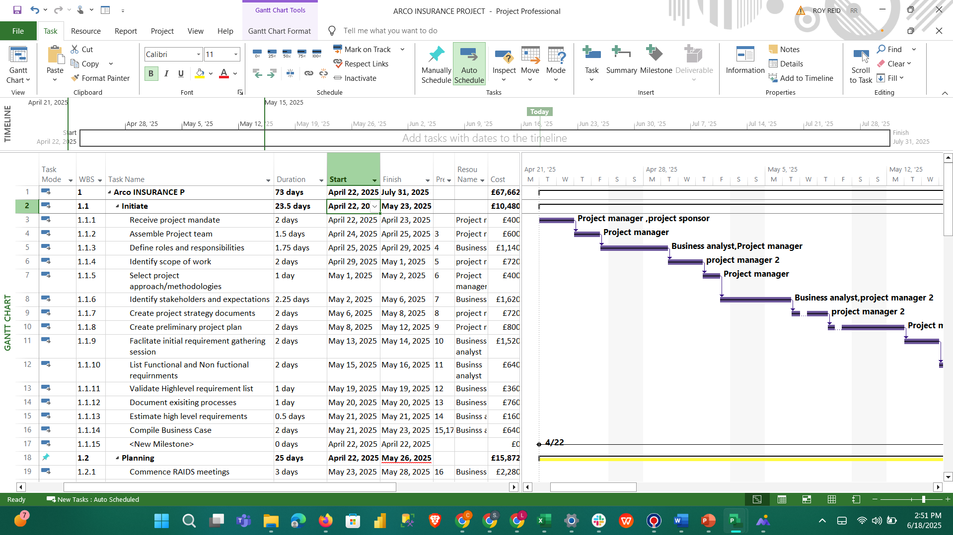

Slide 17
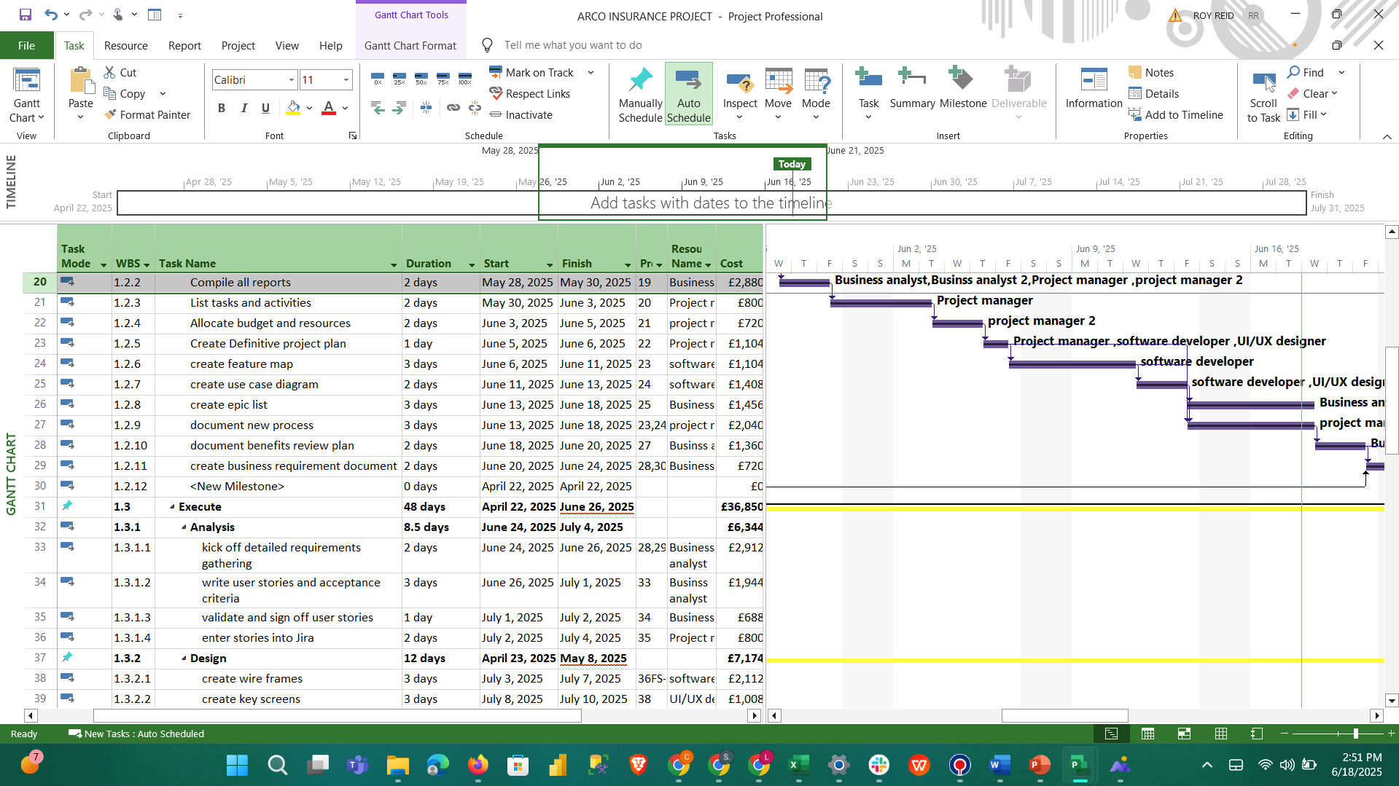

Slide 18
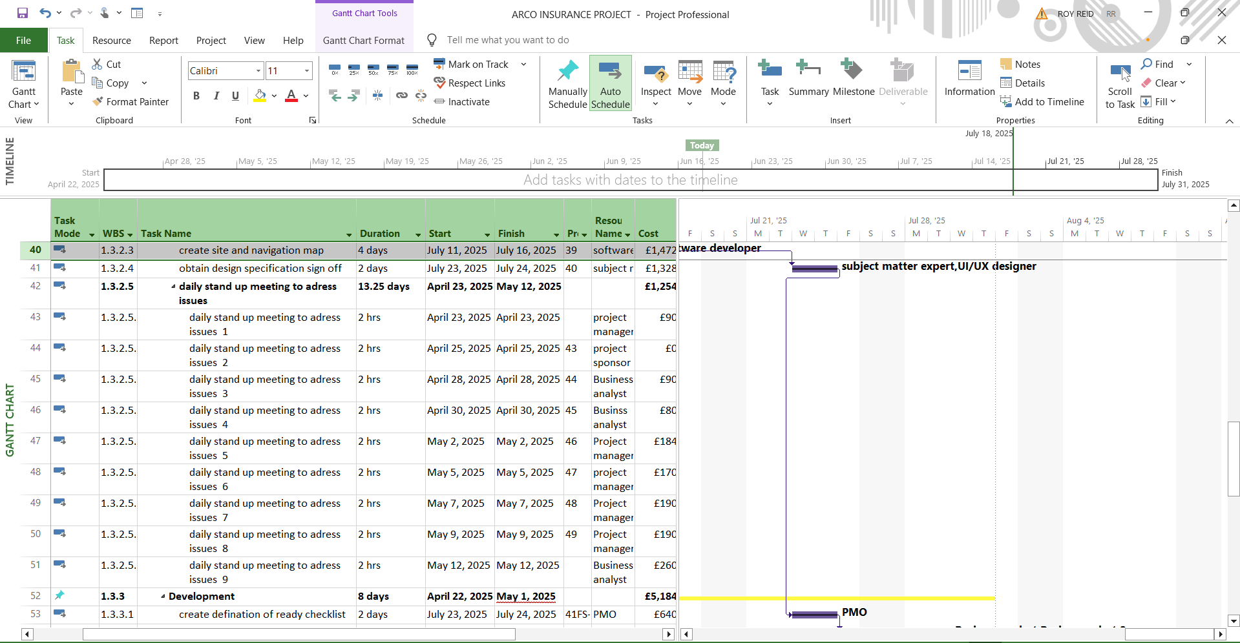

Slide 19
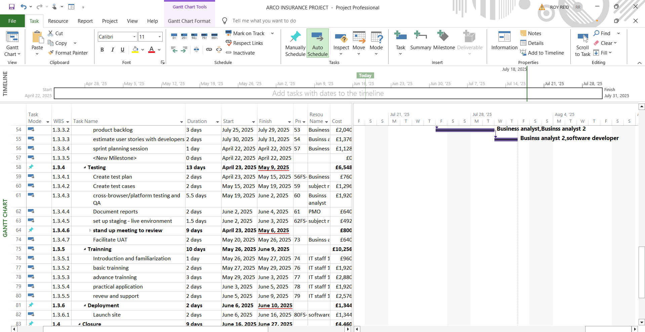

Slide 20
